Slide 1
DMT-induzierte NDEs
Daten aus: https://www.frontiersin.org/journals/psychology/articles/10.3389/fpsyg.2018.01424/full
ORIGINAL RESEARCH article
Front. Psychol., 15 August 2018
Sec. Consciousness Research
Volume 9 - 2018 | https://doi.org/10.3389/fpsyg.2018.01424
DMT Models the Near-Death Experience
M.Schröter-Kunhardt

Slide 2
Die NDE-Skalenwerte unter DMT könnten noch höher gewesen sein
The dose of DMT was not uniform for all participants due to this study being part of a dose-finding pre-study ahead of a larger EEG-fMRI study with DMT. The lower doses of DMT may have actually depreciated the true strength of the similarities between the DMT state and the near-death experience therefore, and we should also acknowledge that individuals included within the ‘actual’ NDE sample had to give NDE-scale scores above a specific threshold, whereas this pre-requisite wasn’t stipulated for our DMT sample.

Slide 3
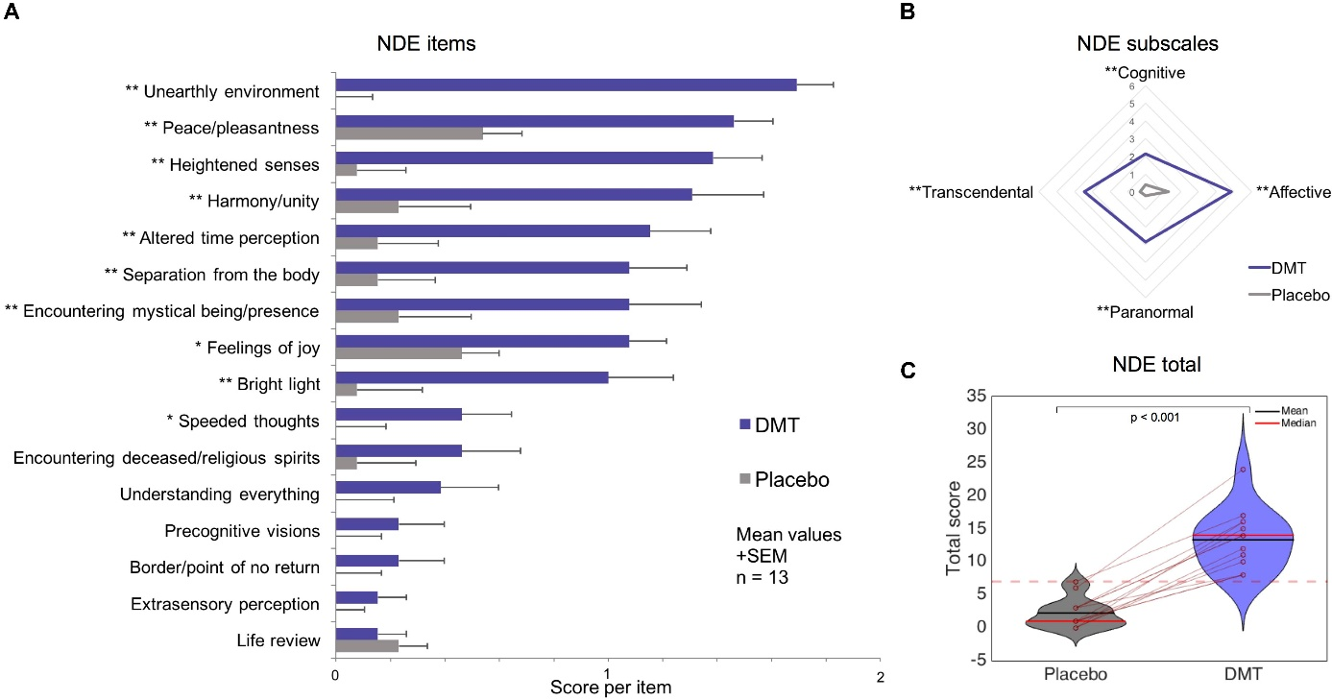
Placebokontrollierte Reproduzierbare Auslösung von NDE-Elementen durch DMT

Slide 4
Placebokontrollierte Reproduzierbare Auslösung von NDE-Elementen durch DMT
FIGURE 1. Near-Death Experience (NDE) scale results for DMT vs. placebo. Significantly larger scores for DMT versus placebo were found for (A) 10 out of 16 items of the NDE scale; (B) all NDE subscales; and (C) the NDE scale total (the dotted red line corresponds to the conventional threshold for determining an NDE) (∗p < 0.05, ∗∗p < 0.01, corrected for multiple comparisons).

Slide 5
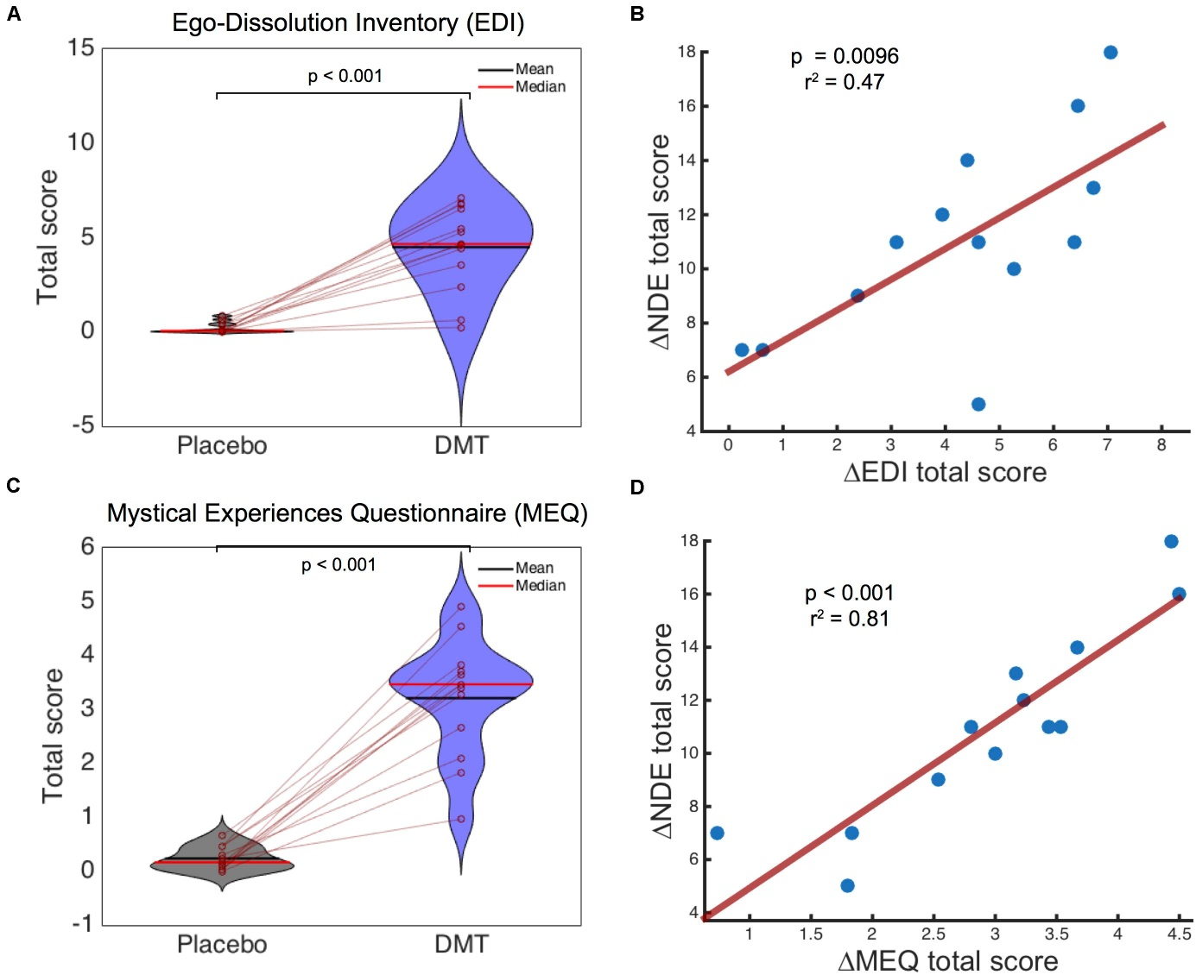
Placebokontrollierte Reproduzierbare Auslösung von NDE-Elementen durch DMT

Slide 6
Placebokontrollierte Reproduzierbare Auslösung von NDE-Elementen durch DMT
FIGURE 2. Ego-Dissolution Inventory (EDI) and Mystical Experiences Questionnaire (MEQ) scores and relationship with Near-Death Experience (NDE) scale scores. Significantly higher scores were found for DMT compared to placebo for (A) EDI and (C) MEQ scores. A highly significantly positive correlation was found between the NDE scale and (B) EDI and (D) MEQ scores following DMT administration.

Slide 7
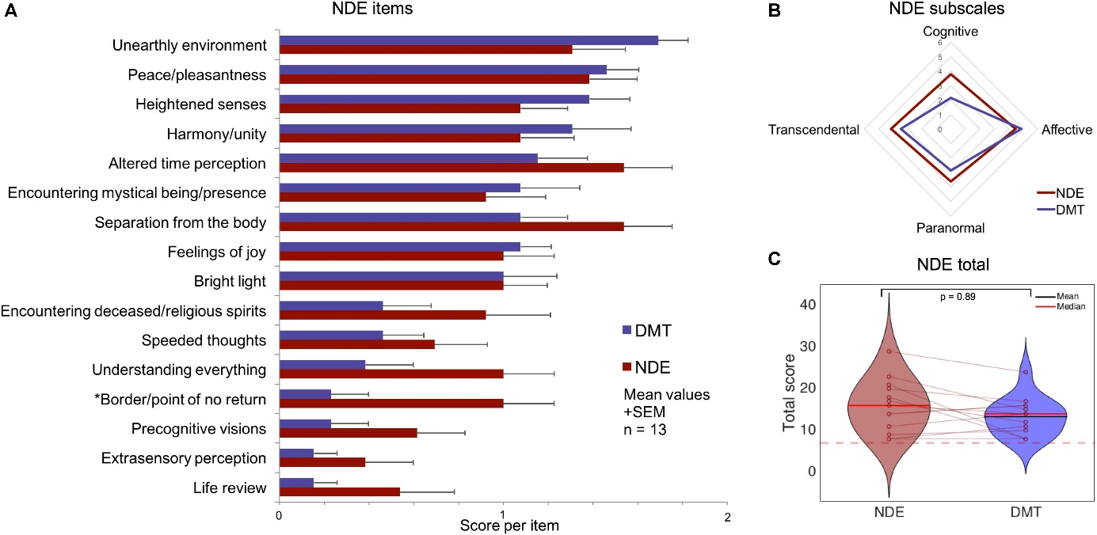
Placebokontrollierte Reproduzierbare Auslösung von NDE-Elementen durch DMT

Slide 8
Placebokontrollierte Reproduzierbare Auslösung von NDE-Elementen durch DMT
FIGURE 4. Comparison of near-death experience (NDE) features in ‘actual’ NDEs and the DMT experience using a standard NDE scale (Greyson, 1983). No significant differences were found between DMT administration and ‘actual’ NDEs for (A) 15 out of 16 NDE scale items; (B) all NDE subscales; and (C) the NDE scale total score (The dotted red line corresponds to the threshold for an NDE). (∗p < 0.05 uncorrected).

Slide 9
Placebokontrollierte Reproduzierbare Auslösung von NDE-Elementen durch DMT
Results revealed that all 13 participants scored above the standard threshold for an NDE in relation to their DMT experiences (Greyson, 1983) and 15 of the 16 NDE items were rated significantly higher under DMT compared to placebo, with 10 of these reaching statistical significance after multiple testing correction.

Slide 10
Placebokontrollierte Reproduzierbare Auslösung von NDE-Elementen durch DMT
Especially strong overlap was seen between DMT-induced near-death type experiences and mystical-type experiences (MEQ, Griffiths et al., 2006, 2016; Kometer et al., 2015), with the Mystical factor of the MEQ (which contains items such as “sense of being at a spiritual height” and “experience of oneness or unity with objects and/or persons in your surroundings”) showing the highest relationship with NDE total scores..

Slide 11
Placebokontrollierte Reproduzierbare Auslösung von NDE-Elementen durch DMT
Intriguingly, DMT-induced NDE scores were significantly correlated with baseline-measured delusional thinking.
Perhaps most interesting of all however, when these DMT data were compared with those from a matched sample of ‘actual’ NDEs, a comparable profile was evident, with few discernable differences between the experiences of the actual NDE cases and those induced by DMT
The Affective subscale of the NDE scale was scored particularly highly under DMT, and emotion is also a prominent feature of actual NDEs (Greyson, 1983, 2003)

Slide 12
Placebokontrollierte Reproduzierbare Auslösung von NDE-Elementen durch DMT
Items that did not survive multiple comparison correction (experiences of extrasensory perception, life-review, precognition of future events, increased speed of thoughts and seeing deceased people/relatives) are also items that are less commonly endorsed in ‘actual’ NDEs (Schwaninger et al., 2002; Greyson, 2003; Vanhaudenhuyse et al., 2009). Schwaninger et al., 2002; Martial et al., 2017).

Slide 13
Placebokontrollierte Reproduzierbare Auslösung von NDE-Elementen durch DMT
Subtle differences that were apparent between the DMT condition and NDEs (e.g., the experience of entering an unearthly realm was enhanced for DMT vs. actual NDEs, whereas coming to a point of no return was scored higher in actual NDEs compared with the DMT experience) may be explainable by the very different contexts in which these experiences occur (e.g., DMT was given here with prior screening, psychological preparation and consent in a safe laboratory setting vs. an NDE occuring during an illness or unexpected accident)

